Slide 1


Final Task Project- Based Intern : Data Scientist Home Credit
TSANIYA NUR SUKMA | 2023

Slide 2
TABLE OF CONTENTS
01
04
02
05
03
TSANIYA NUR SUKMA | 2023
Problem Research
Machine Learning Implementation & Evaluation
Data Pre-Processing
Business Recommendation
Data Visualization & Business Insight

Slide 3
PROBLEM RESEARCH
01
Problem Statement
Losses generated from customers who stutter are quite high, so as a Data Scientist, they must help to minimize these losses by creating a predictive model for customers who have the potential to fail to pay.
Goals
Create a credit risk prediction model
Business Metric
Area Under the ROC Curve (AUC-ROC)

Slide 4

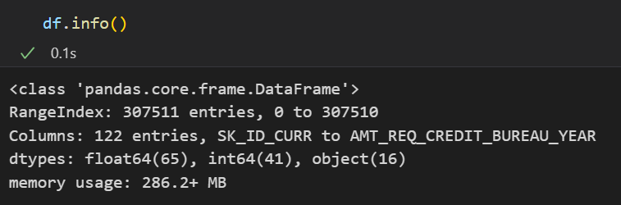

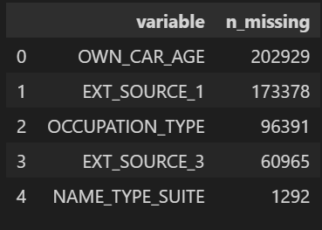


DATA PRE-PROCESSING
TSANIYA NUR SUKMA | 2023
From the results of data understanding, there are columns that have high missing values, so they need to be removed because they do not really affect the test and it is known that the data does not have duplicate values.

Slide 5
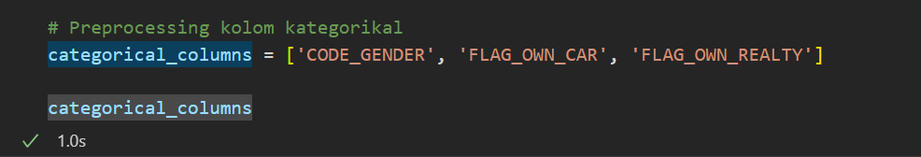
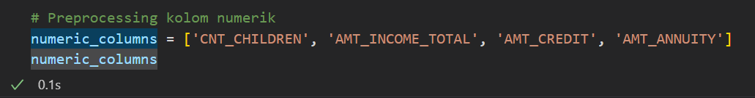
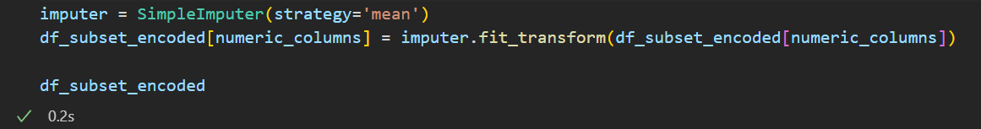
DATA PRE-PROCESSING
TSANIYA NUR SUKMA | 2023
of the missing value then changed to the mean value

Slide 6
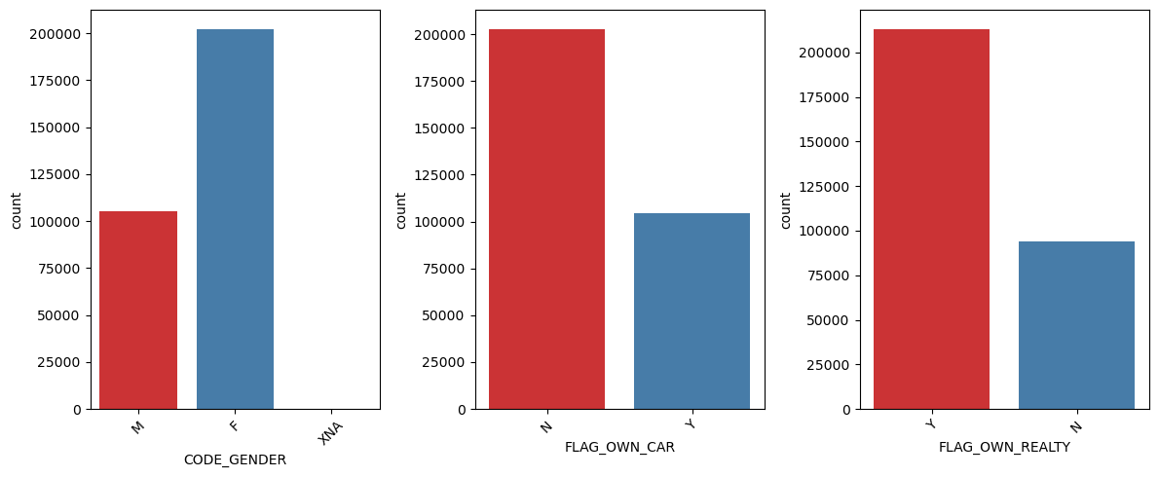
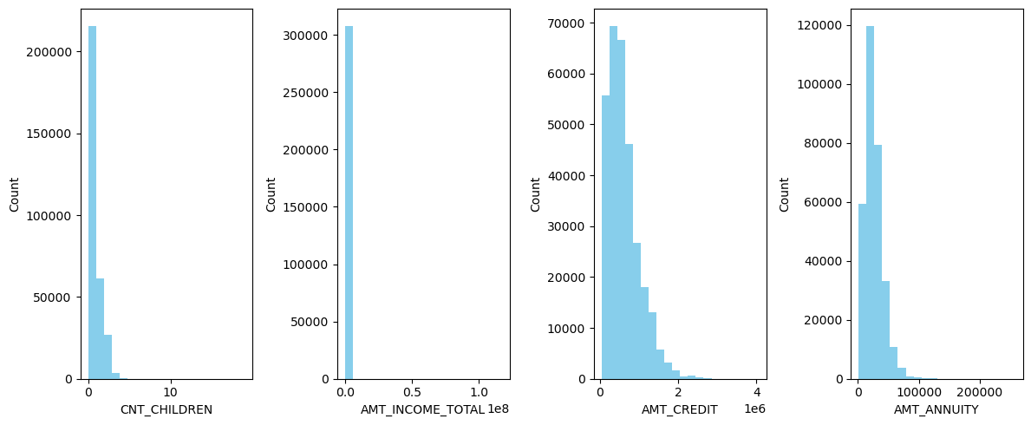
DATA VISUALIZATION
Categorical
The figure beside is a distribution graph between categorical and numerical columns where, the data are spread quite differently, but almost every column is positively skewed
Numerical

Slide 7
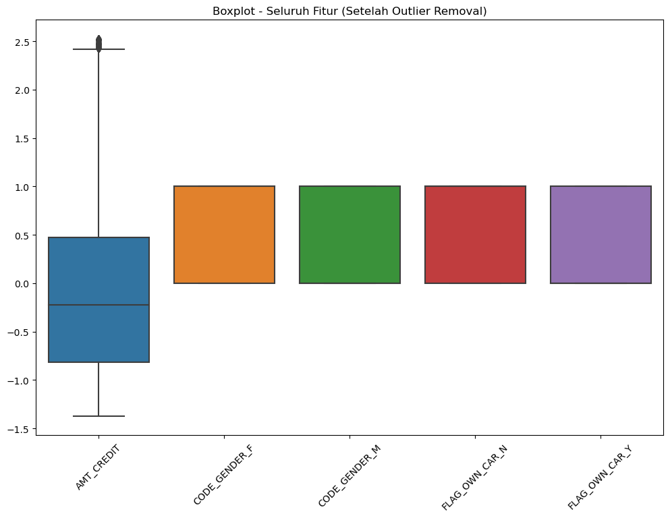
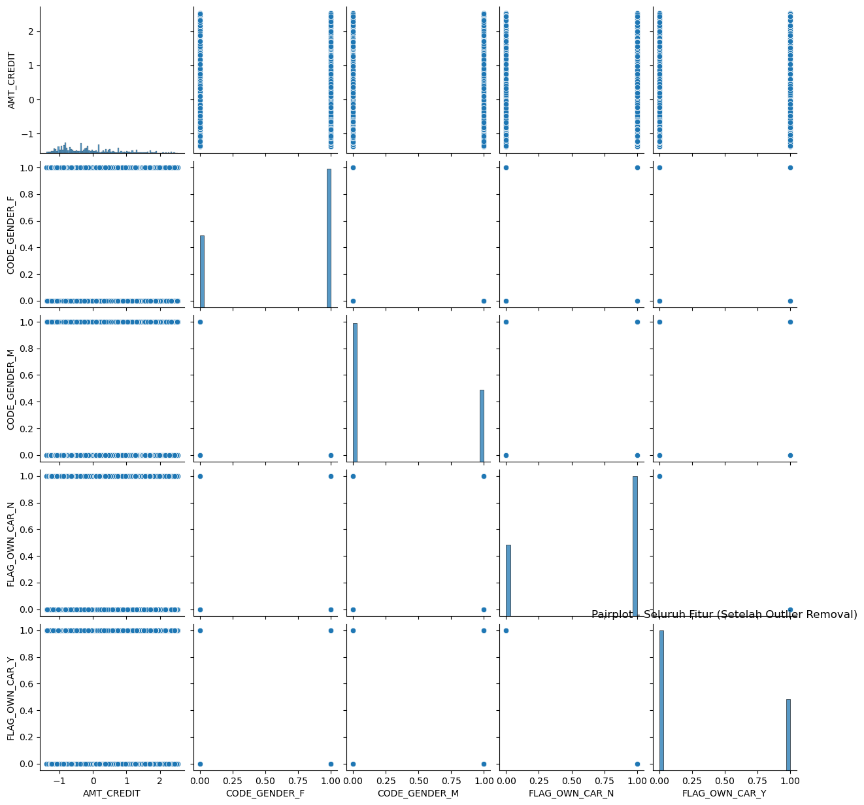
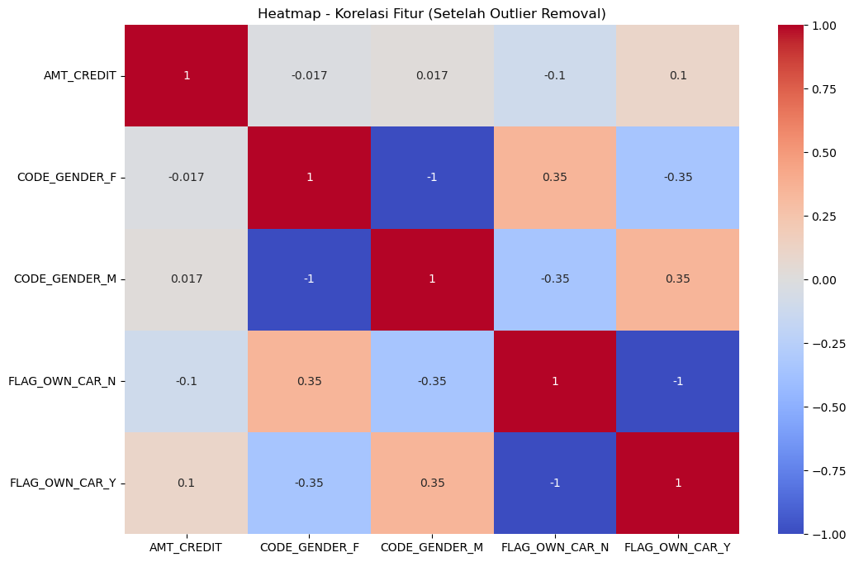
DATA VISUALIZATION
TSANIYA NUR SUKMA | 2023
Barplot
Pairplot
Heatmap

Slide 8
BUSINESS INSIGHT
TSANIYA NUR SUKMA | 2023
1. Pairplots:
there is a positive relationship between the number of loans granted (AMT_CREDIT) and ('AMT_INCOME_TOTAL'), this can provide insight that higher credit applications tend to be associated with higher income.
2. Boxplots:
if there are outliers in the variable amount of credit (AMT_CREDIT), this can indicate that there are unusual or specific cases that need further attention and investigation.
3. Heatmap:
there is a strong positive correlation between the amount of credits granted (AMT_CREDIT) and the total income of applicants (for example, features such as 'AMT_INCOME_TOTAL' or 'AMT_ANNUITY'), this may give an indication that income of applicants is an important factor in determining the amount of credits that can be granted.

Slide 9
MACHINE LEARNING IMPLEMENTATION & EVALUATION
TSANIYA NUR SUKMA | 2023
The model is made with Logistic Regression by first training the model after it has been balanced.
in this model a prediction of the target value for the data being tested is carried out by changing the scale to 1 where the metric used is AUC_ROC.
when calculating the metric score, the result is 1, which means that the model is perfect in distinguishing positive and negative classes. However, to investigate further, several other metrics such as precision, accuracy and recall were carried out and the results showed 1.0 so that the model achieved perfect performance on the test data and cross-validation that had been carried out.

Slide 10
Business Recommendation
TSANIYA NUR SUKMA | 2023
Credit Risk Assessment: Features such as payment history (CREDIT_HISTORY), active loan amount (AMT_CREDIT_ACTIVE), or arrears amount (AMT_CREDIT_LATE) can be used to develop credit risk assessment models. With this model, you can identify customers with high credit risk and take appropriate steps to manage those risks.
THANK YOU!!!!
You can find me at Repository GitHub:
https://github.com/Tsaniyans

